Slide 1
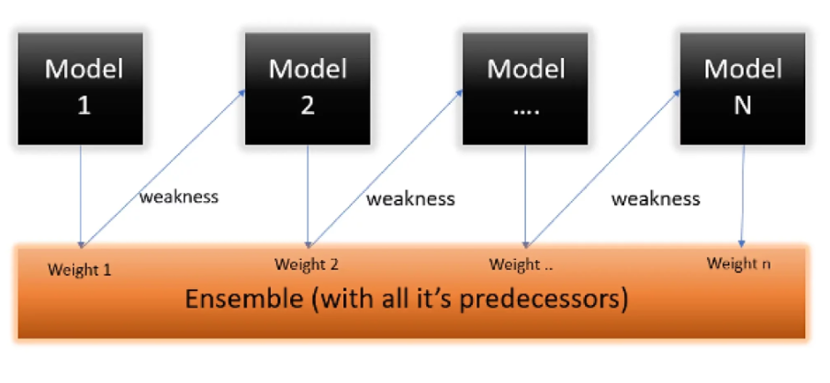
ADA Boost Algorithm
It is Adaptive
boosting algorithm.
Ensemble model is built
sequentially and each new
model builds on the results
of the previous one,
trying to improve its errors.

Slide 2
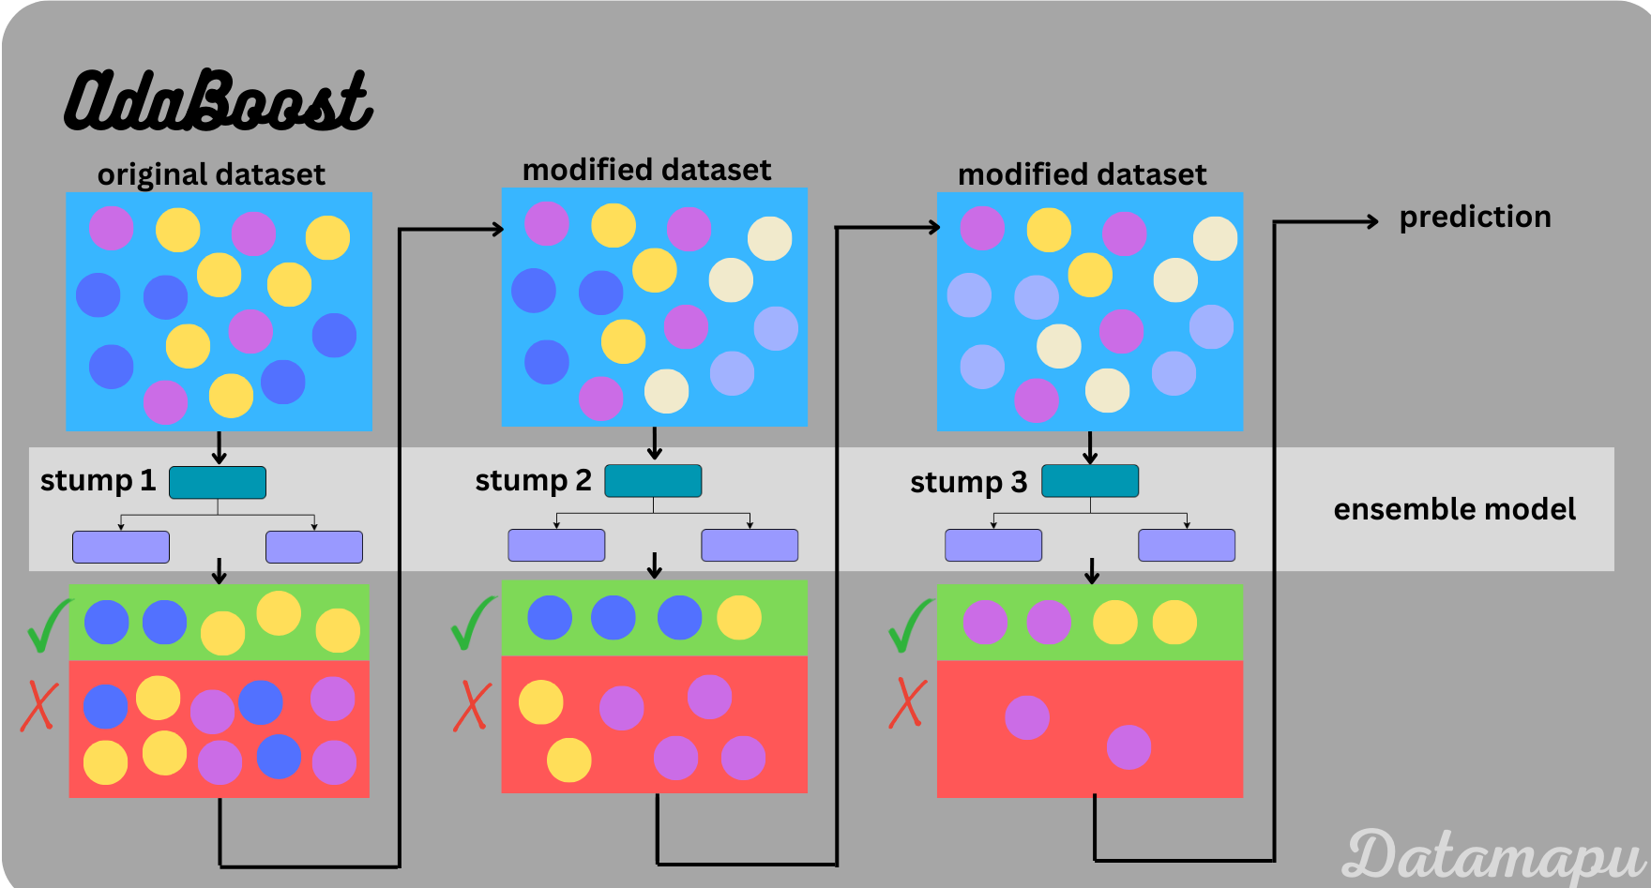
Sample problem:
Combines multiple weak classifiers to create a strong classifier.
Focuses on the errors made by previous models, giving more weight to misclassified instances, and improves accuracy by iteratively adjusting the model.

Slide 3
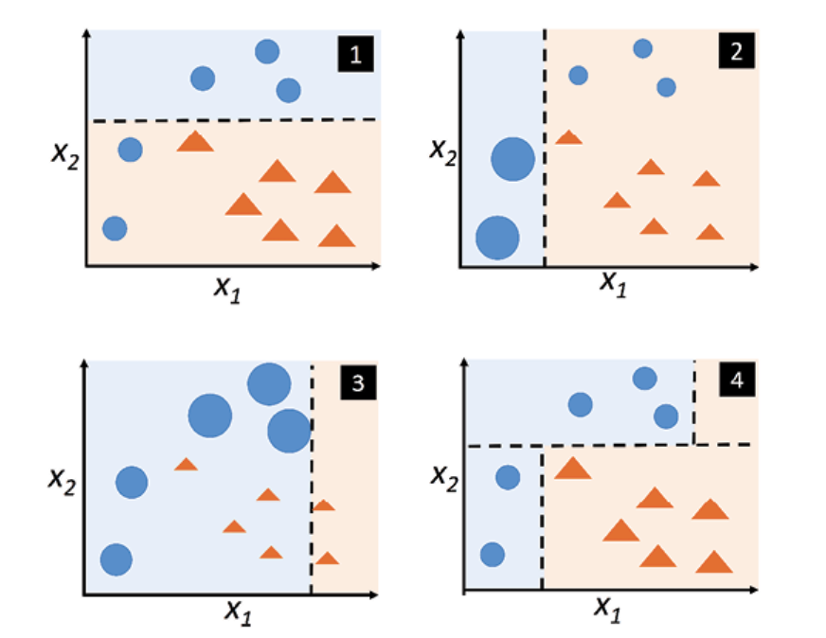
For more understanding
Adapting boosting combines (boosts) the weak learners to form a strong learner.

Slide 4
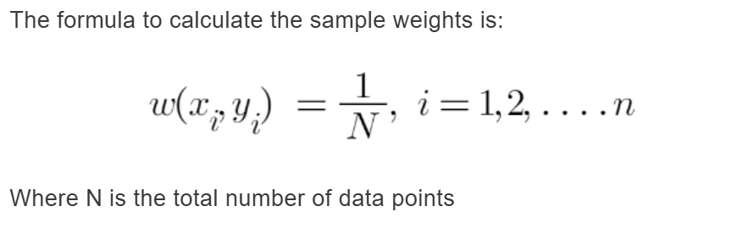
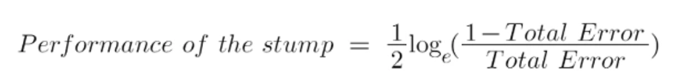
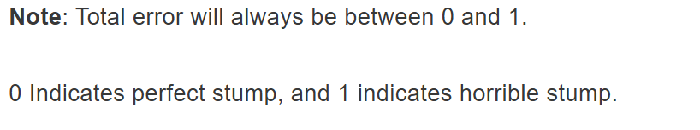
Understanding the AdaBoost Algorithm

Slide 5
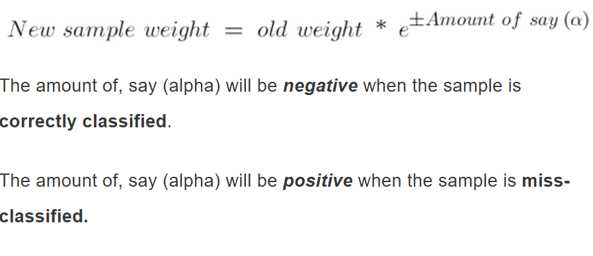
Calculate TE and Performance
Performance of the sample and amount of say both are (∝)

